Slide 1


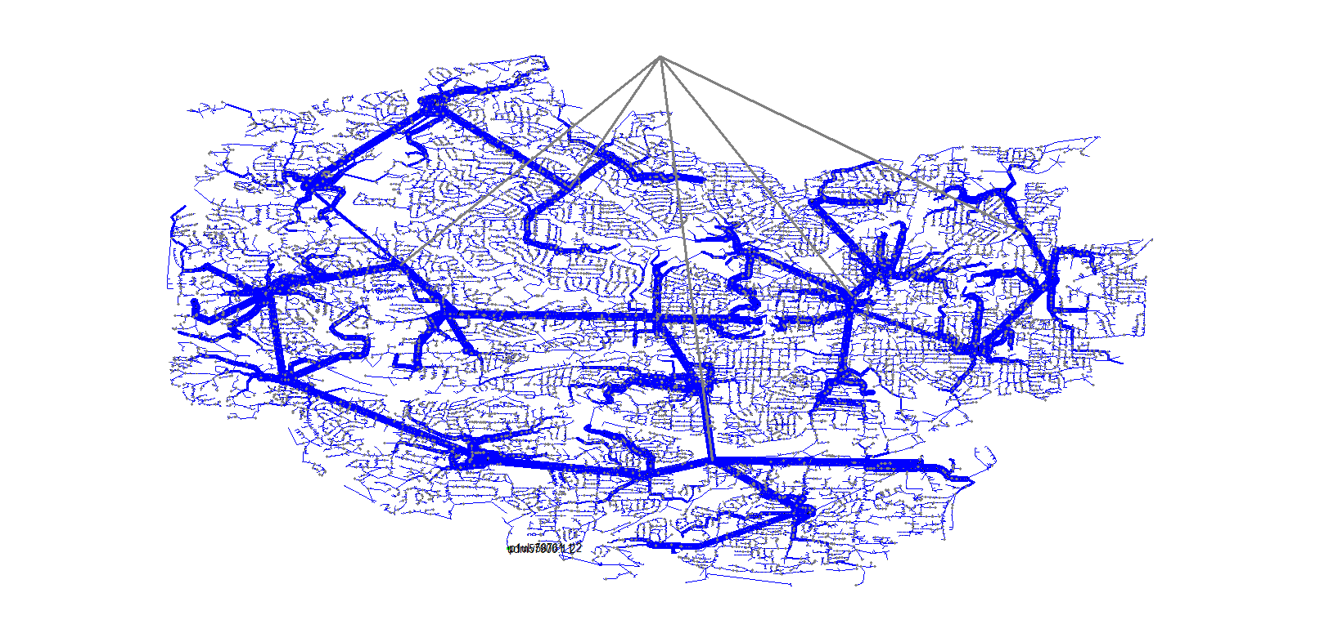
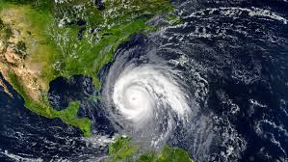

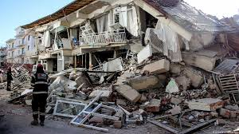


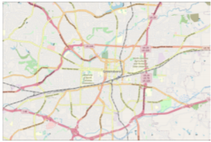





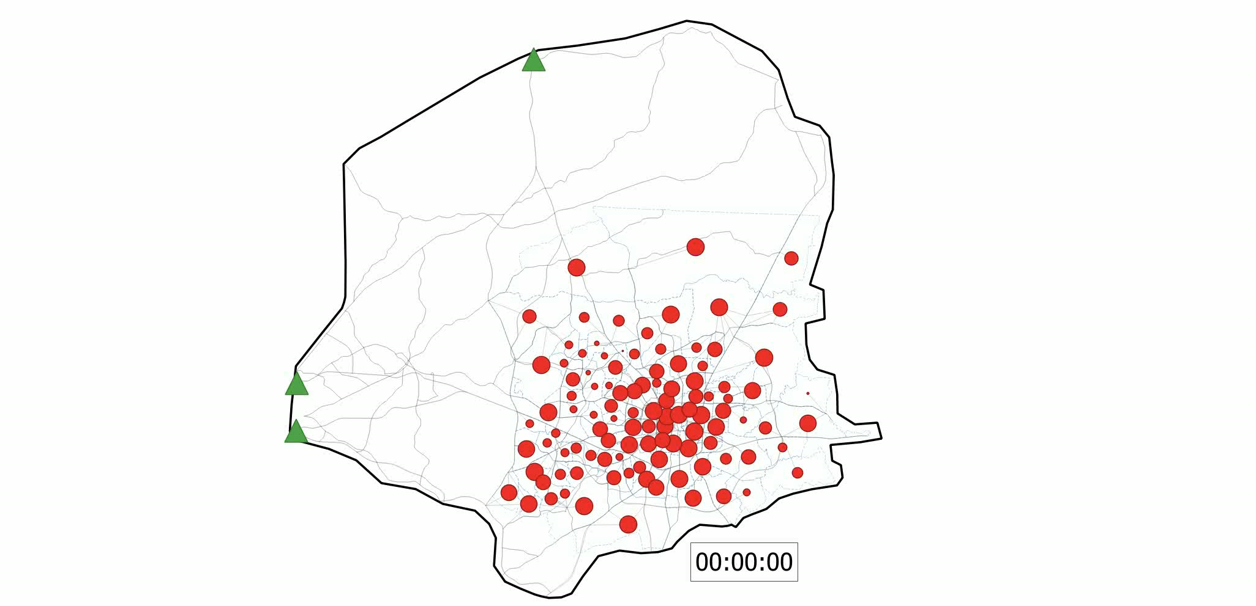



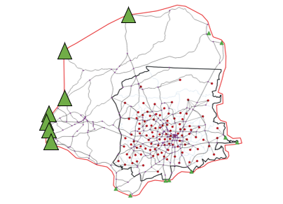
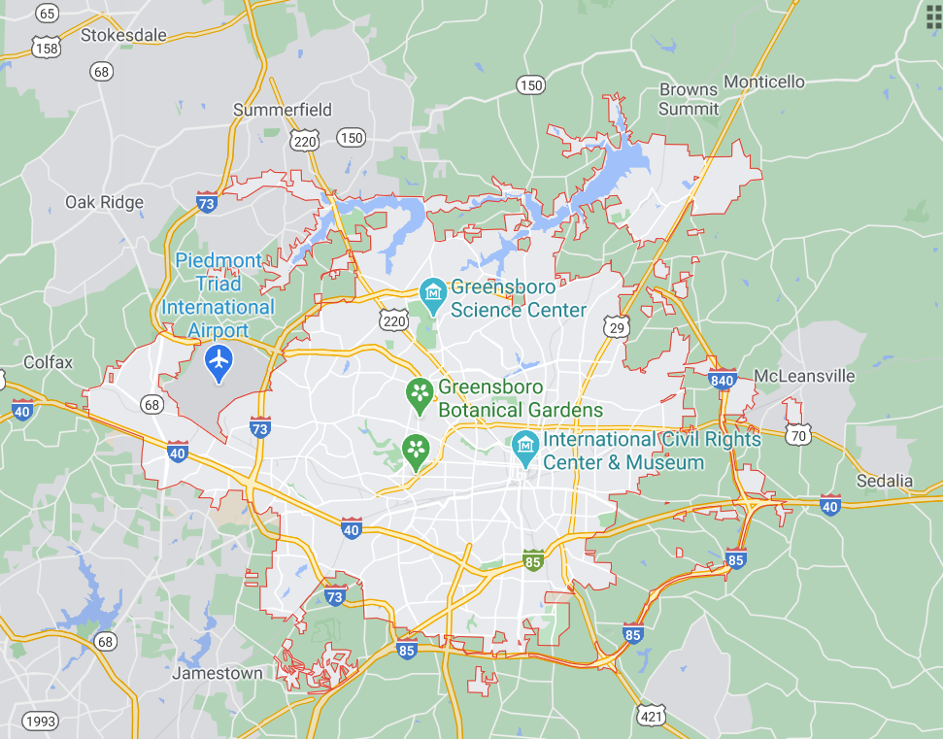
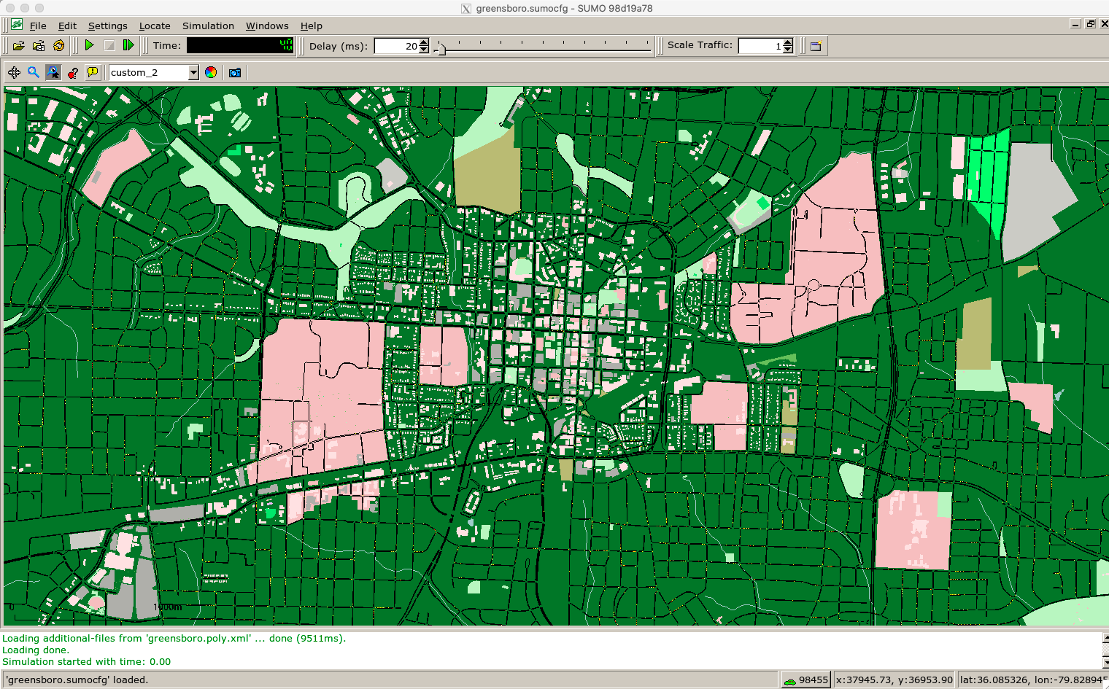
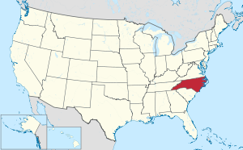

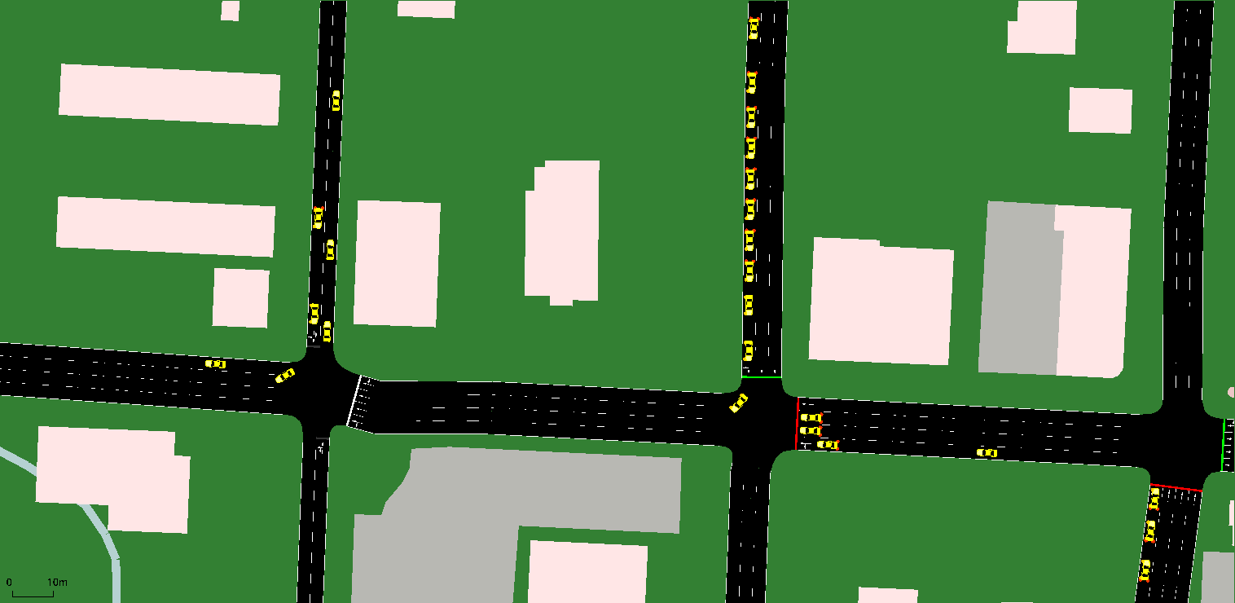
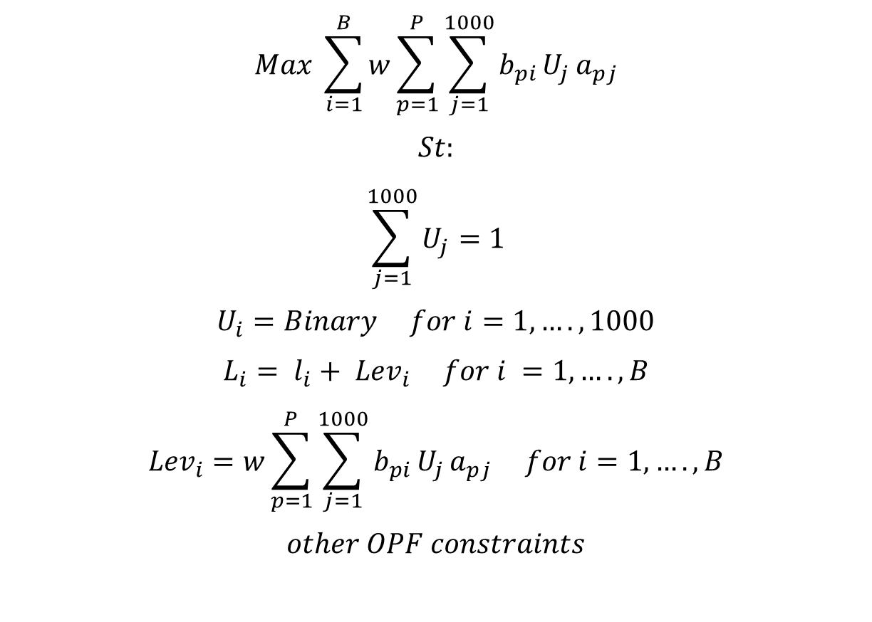
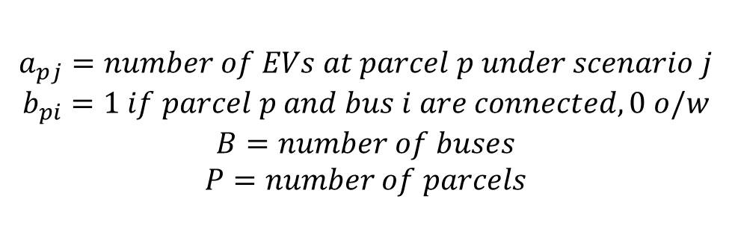
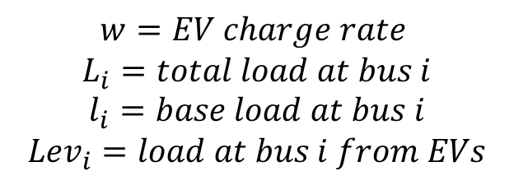
How high penetration of electric vehicles (EVs) impacts the way we evacuate cities
A.D. Owen Aquino, J.A. Huertas, G. Nilsson, K. Iles, S. Coogan,
P. Van Hentenryck, D.K. Molzahn
Georgia Institute of Technology
Electric Network
Motivation
EV allocation
Parcels
Buses
(a) (b) (c)
Census tracts
Figure 1. When natural disasters such as hurricanes (a), wildfires (b), or earthquakes (c) occur, cities need to be evacuated quickly.
Figure 3. Illustration of Greensboro’s Urban/Suburban distribution network.
TAZs
Feeders
Using LANL’s PowerModelsDistribution [1]:
Run power flow calculations on distribution feeders to determine if adding different amounts of EVs overload any part of the grid
Run optimization problems to determine the largest percentage of vehicles that can be electric, and the best charging strategy during an evacuation.
Figure 6. Vehicles need to be distributed, and EVs assigned along different levels; from individual parcels, to buses in the electric grid, to TAZs in the transportation network.
(a)
The number of vehicles at each TAZ in Greensboro is obtained from county data. Then, each parcel is assigned vehicles depending on the parcel type
(b)
The number of EVs in NC is taken from publicly available data. EVs are distributed among TAZs in proportion to the tract’s income. TAZs with larger average incomes are given more Evs. Parcels are connected to buses based on their proximity on a map
$$Max \sum_{i=1}^{B}{w\sum_{p=1}^{P}{\sum_{j=1}^{1000}{b_{pi}}U_{j}}}a_{pj}$$
$$St:$$
$$\sum_{j=1}^{1000}{U_{j}}=1$$
$$U_{i}=Binary for i=1,….,1000$$
$$L_{i}= l_{i}+ {Lev}_{i} for i =1,….,B$$
$${Lev}_{i}=w\sum_{p=1}^{P}{\sum_{j=1}^{1000}{b_{pi}}U_{j}}a_{pj} for i=1,….,B$$
$$other OPF constraints$$
Maximize EV power consumption
Figure 2. When only gasoline cars are assumed (a), evacuation plans only need to consider the transportation network dynamics. When a large fraction of the vehicles are electric (b) the electric network needs to be considered to avoid an overload of the grid and stranded evacuees.
Decision variable that determines which precomputed scenario of ‘% of EV’ is selected
After vehicles are distributed along parcels and buses, some of them are assigned as EVs proportional to the base load at that bus and the number of EVs in that TAZ determined in step 2. The vehicles in buses with higher loads have larger chances of being “turned” into EVs.
The load at each bus = base load + EV load
The EV load at each bus is given by a EV charge rate * the sum of the number of EVs at each parcel linked to that bus at a specific ‘% of EV’ scenario
Simulations
$$w=EV charge rate$$
$$L_{i}=total load at bus i$$
$$l_{i}=base load at bus i$$
$${Lev}_{i}=load at bus i from EVs$$
$$a_{pj}=number of EVs at parcel p under scenario j$$
$$b_{pi}=1 if parcel p and bus i are connected, 0 o/w$$
$$B=number of buses$$
$$P=number of parcels$$
The project consists of three main thrusts:
Modeling of coupled power and transportation infrastructure for evacuation
Large-scale optimization with coupled constraints and uncertainty
Simulation validation.
The aim is to develop a methodology for evacuation planning that accounts for both the transportation network dynamics and the power grid model.
The optimization results and theoretical findings are simulated and validated with Simulation of Urban Mobility (SUMO) [5]. The simulations will accommodate several different scenarios:
Deadline driven, where the area needs to be evacuated before a particular known time, for example, before a hurricane arrives
Continuous, where the disaster is ongoing and there may be a continuous and changing impact on infrastructure networks, for example, during a wildfire
Post-disaster, where the disaster has already occurred and impacted the infrastructure network, for example, after an earthquake.
The electric and transportation models communicate through pre-computed linear constraints given by the electric model and incorporated into the evacuation problem.
Transportation
Case study
Area of interest
Evacuated area
Evacuation node
Safe node
Figure 4. Illustration of Greensboro’s evacuation instance.
Figure 5. NREL’s Synthetic Models for Advanced, Realistic Testing: Distributions System and Scenarios (SMART-DS) [4] offered high quality, “realistic but not real” data sets from San Francisco, CA, Santa Fe, NM, and Greensboro, NC. Greensboro was selected as the test case for this project because of its medium size and several possible evacuation routes. Also, by artificially limiting the evacuation routes of this inland city, different types of geographic characteristics (e.g., costal cities) can be simulated.
Optimization techniques have been successfully applied to evacuation problems for non-electric vehicles [2][3]. These zone-based evacuation planning problems (ZEPP) assign a path and departure times to each zone that needs to be evacuated.
In this project, we add new constraints to these ZEPP obtained from the electric grid models to be able to assign charging times for the EVs.
Figure 7. SUMO traffic simulation of Greensboro, NC.

